Slide 1



Innovating Together. Solving Smarter.
Empowering businesses through collaboration, innovation, and technology. As your trusted partner, we deliver excellence through cutting-edge solutions tailored to your unique challenges.
www.swajaysolutions.com

Slide 2
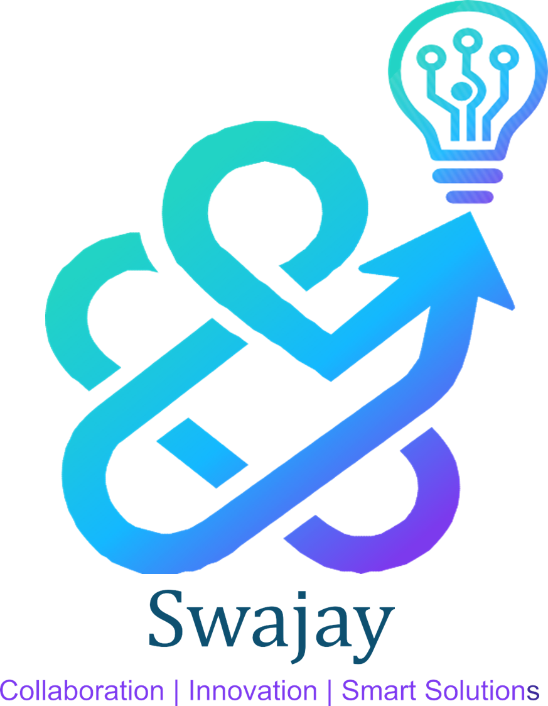
Vision
To deliver intelligent Automation and AI solutions that
empower organizations in Mortgage,
BFSI/Healthcare, Commerce, and Legal domains to
achieve superior customer outcomes and operational
excellence.
Our Purpose
Mission
Make advanced AI Solution useful and
affordable—shipped quickly, run responsibly, and
scaled with customers.
Outcome with agility & Speed - Reuse before reinvent - Information and Data Privacy by default

Slide 3











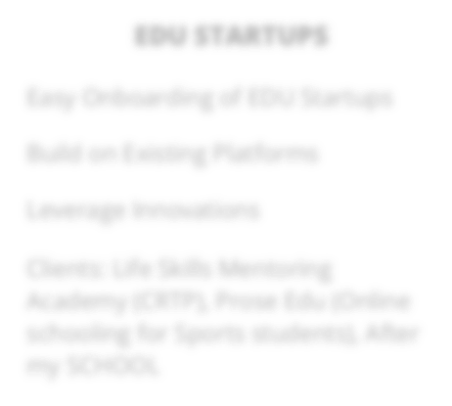
Our Mortgage Functional Capabilities
Title Search
LOS (Loan Origination System)
..
Curative Services
Comprehensive property title research and examination services, processing 3,000+ orders monthly with zero defects. Our AI-powered workflows ensure accuracy and speed.
End-to-end loan origination support, from application through approval. We streamline processes and integrate seamlessly with existing systems.
Expert resolution of title defects and encumbrances, ensuring clean title transfer. Our specialists handle complex situations with precision.
Document Processing
Compliance & Quality
Process Automation
Intelligent document extraction, validation, and management using advanced AI and OCR technology for faster, more accurate processing.
Rigorous quality assurance and regulatory compliance monitoring to protect your business and maintain the highest standards.
End-to-end workflow automation reducing manual effort by up to 70%, allowing your team to focus on high-value activities.
13

Slide 4
Our Blueprint of Technology Excellence
We move beyond traditional BPO by embedding advanced technology—from proprietary applications to sophisticated AI models—directly into your title, settlement, and mortgage workflows.
Swajay leverages its multi-industry expertise to deliver secure, scalable, and outcome-driven digital solutions.
Engineering Services
AI & Advanced Automation
Data & Business Intelligence
Custom, user-centric software that streamlines interaction and scaling.
Machine learning and generative AI to manage complexity and eliminate errors.
Unified, governable data platform for strategic decision-making.
Web & mobile application development
Agentic AI solutions
Data modernisation
Technology consulting
Workflow automation
ETL engineering
Quality engineering
RPA (Blue Prism, UiPath)
Analytics & visualisation
Secure Cloud & Integration
Compliant, flexible foundation connecting all systems seamlessly.
Cloud migration & optimisation
Infrastructure engineering
Integration solutions

Slide 5






AI & Automation: Eliminating Manual Bottlenecks
We apply specific AI solutions to mission-critical mortgage and title processes, transforming time-consuming
tasks into compliant, automated workflows.
Intelligent Document Processing
Agentic AI for Order Management
RPA for Report Generation
AI-powered extraction and validation across all title documents (deeds, mortgages, releases) with greater speed and accuracy.
Fully automated order management workflow achieving 100% adherence to client SLAs and reducing order management time by 20%.
BluePrism-based bot retrieving loan details and generating reports, resulting in 90% improvement in cycle time (from 120 mins to 4 mins).
Data & Product Engineering: Driving Insight and Experience
Custom Application Development
Data Strategy & Cloud Migration
Business Intelligence
Microservices-based web and mobile application resulting in zero downtime and 30% reduced infrastructure cost.
Migrated on-premise data to Snowflake Cloud, achieving 30% cost savings and 94% increased report generation efficiency.
Unified data view and visualisations uncovering fresh business insights for quick management action.

Slide 6





Swajay’s Approach: Accelerators + Squads
Building faster and smarter through specialized teams, proven methodologies,
and outcome-driven collaboration.
Outcome-First
Lean Co-Build Squad
Define success upfront for one high-impact use case, prioritizing features that directly move the business needle.
Dedicated specialists with deep mortgage business and technology expertise work in sync with your team.
Guaranteed ROI: Focus on measurable results like reduced cost, faster processing time, or zero defects.
Speed & Agility: Weekly demos and transparent decision-making keep momentum high.
Model - Agnostic
Trust by Design
Flexible approach, choosing the right AI model (ChatGPT, Claude.ai) that fits your specific accuracy, budget, and regional needs.
Security, access control, and audit trails are baked into every solution from the start.
Flexibility & Precision: The right tool for the job, ensuring optimal performance.
Mitigated Risk: Strict adherence to industry regulations and client data
confidentiality by default.

Slide 7
Mortgage Title Automation Platform – End-to-End Architecture
Intake
LOS / Lender Orders
Title Search
Public Records
Curative
Issue Identification
Settlement
Compliance Checks
Documents & Data
Data Extraction
Resolution Tracking
Package Assembly
Delivery
Lender/Client
Audit-Ready Output
AUTOMATION & AI OVERLAY
🤖 RPA 📄 Intelligent OCR 🧠 AI/ML Decision Engine 🔄 Workflow Orchestration 🔗 API Integrations 🔒 Audit & Compliance
ROI – METRICS:
50–70% reduction in manual effort 30–50% faster turnaround
20–40% operating cost reduction Higher lender retention due to SLA consistency

Slide 8



Outcomes & Plan (POC → MVP)
Prove it, then scale
Expand: Bi-weekly Releases
Continuous expansion of features and integration with your systems, ensuring value delivery every two weeks.
2 to 4 Weeks POC
Focus on one high-impact flow to demonstrate feasibility, establish clear success criteria, and determine a Go/No-Go decision.
4 to 8 Weeks MVP
Launch a working solution with real users and your data to achieve measurable results (quicker document prep, reduced support load).

Slide 9



Proof points
Experiencing Customer Pull in the Market
YEAR 1
INCEPTION
YEAR 2
EXPANSION
1. Processing 1000 + title search orders
1. Expanded functional landscape from Title to Curative and LOS.
1. AI Governance Platform
2. Scaled Volumes, processing 3000+ orders
2. Zero defect delivery
3. Reputed law firms as clients
2. Expanded Clientele base
3. AI based order management solution

Slide 10

A Revolutionary Approach –
What Happens Next
Let’s Get Started
Pick your “business critical” use case—let’s start the POC

Slide 11


We’re Ready
to Scale.
Looking Forward to Partnering with Customers Who Share that Vision
+91-9986502926
Nagaraj.s@swajaysolutions.com www.swajaysolutions.com

Slide 12
Our Sample Clients
Trusted by leading organizations across mortgage, healthcare, commerce, and legal sectors. Our diverse client portfolio reflects our versatility and commitment to excellence across multiple industries.
Mortgage & Real Estate
Leading title companies and lending institutions rely on our expertise for mission-critical operations, processing thousands of orders with zero defects.
Law Firms
Reputable legal practices trust our technology solutions to streamline their workflows and enhance client service delivery.
Banking Organizations
Healthcare providers leverage our AI and automation capabilities to improve patient care and operational efficiency.
Commerce & Retail
E-commerce and retail companies partner with us to modernize their technology infrastructure and data analytics capabilities.

Slide 13

11

Slide 14

Automating Report Generation
Problem Statement:
Members from the Servicing group had to retrieve customer loan details from multiple sources and applications
Enter the retrieved details, a pre-defined set of investor codes, and current date into a mainframe system for the report to get generated in AIP portal.
Manually this entire process was time consuming as there were multiple systems involved, leading to additional cost and manual errors resulting in the generation of inaccurate reports.
Solution: Implementation Duration : 2.5 Sprints including 0.5 Sprint design & 1 Sprint implementation
Discovery Process:
Detailed Process Analysis identifying bottlenecks and opportunities for process refinements
Collaborating with business team and IT teams to outline the automation solution
Combination of BluePrism based RPA bot enabling a seamless experience
Execution
Login to the loan sphere application, traverse through the menu and select one of the pre-defined menu options
MSP Explorer window opens where current date, Investor codes and certain other customer / loan details are entered and click submit.
A report gets generated and sent to business team for further action.
Built using Blue Prism and it integrates with Web as well as Mainframe application as part of automation process.
Integrates with MS Outlook exchange to send out notifications.
"I have had nothing but great experiences working with the Team. The team has been a great partner, quick to take up projects, explore a multitude of potential solutions to highly complex needs, and deliver results quickly. Communication has been quick, efficient, and they have made themselves available for supplementary calls as needed to complete their work and gain additional clarity into the solutions we are solving for. I’ve really enjoyed working with this team and look forward to continuing our work together."
----- Chief Operating Officer
Value Add:
90% improvement in cycle time – reduced from 120 mins
to 4 mins
$80K to $100K Annual Cost Saving Optimization on FTE
Empowering businesses through collaboration, innovation, and technology.

Slide 15

AI Solution - Automating the entire order management workflow
Problem Statement:
The order management process starting from receipt of orders through mails and managing it through execution process was all manually done
Challenges included – missing SLA’s, Accuracy in management, potential human errors, Time consumption
Solution: Developed AI based solution in 2 weeks that completely automated the entire order management process
Discovery process
Detailed Process Analysis identifying bottlenecks and opportunities for process refinements
Collaborating with business team and IT teams to outline the automation solution
AI Based solution design and demo of MVP
Execution
All user persona’s and actions captured.
Developed UI for various roles
All rules were built integral to solutions and validated
Edge case scenarios identified and solution enhanced to handle it
Performance of solution for high loads tested to ensure minimum latency
QC checks for automated order execution process and productionized the solution post achieving 100% accuracy..
Value Add:
100% adherence to client SLA’s
Reduced Order Management time by 20%
Cost optimization by eliminating manual intervention
resulting in 20K USD savings
Empowering businesses through collaboration, innovation, and technology.

Slide 16





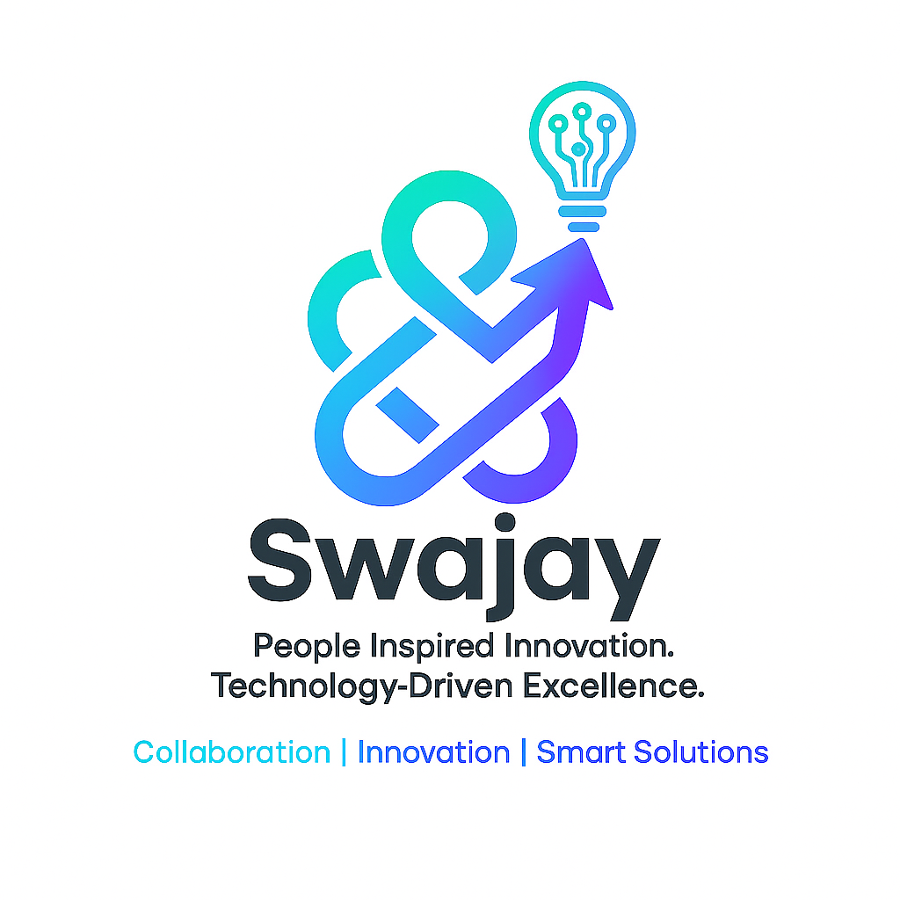
Developed Web & Mobile application for a Seasoned Mortgage Lender
Problem Statement:
Mortgage applications process was lengthy, difficult to scale, maintain & update due to tightly coupled architecture
Non user-friendly applications for Customer Interaction
Frequent downtime of the applications resulting in business loss
Existing applications were not Accessibility compliant (ADA, WCAG etc.,)
Solution Offered:
Defined a transformation approach to migrate Monolithic based application to Microservices application
Enriched UI interface to enhance CX
Migrated the services from on-premise to cloud
Developed mobile application which is 100% American Disability Act Compliant
Technologies:
Java
Springboot
React JS
AWS components & services
REST API
Value Add:
Zero downtime since product got launched in Sep’22 with full load of 1.7M customers.
Reduced infra cost by 30% after cloud migration
Increased user volumes to 60K per day due to increased API response time (<2 secs)
Drastically reduced calls to call-center because of the user-friendly application
Empowering businesses through collaboration, innovation, and technology.

Slide 17

Define & Implement a Data Strategy & Platform for a Leading Mortgage Company
Problem Statement:
Unstructured mortgage data scattered across disparate systems leading to inefficient & inaccurate business insight generation
Difficult to manage the high-volume data as they were located on-premise making cost expensive & time consuming for scaling up/down
No technical/data strategy
Adhoc & unstructured jobs
Solution Offered:
Created a unified data view & developed visualizations to help business infer the data better and make accurate decisions
Migrated data from on-premise SQL server to Snowflake cloud
Cumbersome SQL statements are converted to simple SSIS transformations
Automated generation of complex reports based on cadence defined by business
Tools & Technologies:
SSIS
SSRS, PowerBI
SQL, SSMS
Snowflake
“The ETL team has been a great partner. The Swajay team has been quick to take up projects, explore a multitude of potential solutions to highly complex needs, and deliver results quickly. Communication has been quick, efficient, and they have made themselves available for supplementary calls as needed to complete their work and gain additional clarity into the solutions we are solving for. I’ve really enjoyed working with the team and look forward to continuing our work together. “
----- Data Analysis Director
Value Add:
Uncovered fresh business insights such as bankruptcy details, foreclosure details which helped management team to take appropriate & quick action
Increase in sales by 5% with provision of area sales reporting
30% of cost saving after moving data from On-Prem to Snowflake
Increased the efficiency of report generation by 94%

Slide 18
THANK YOU

Slide 19
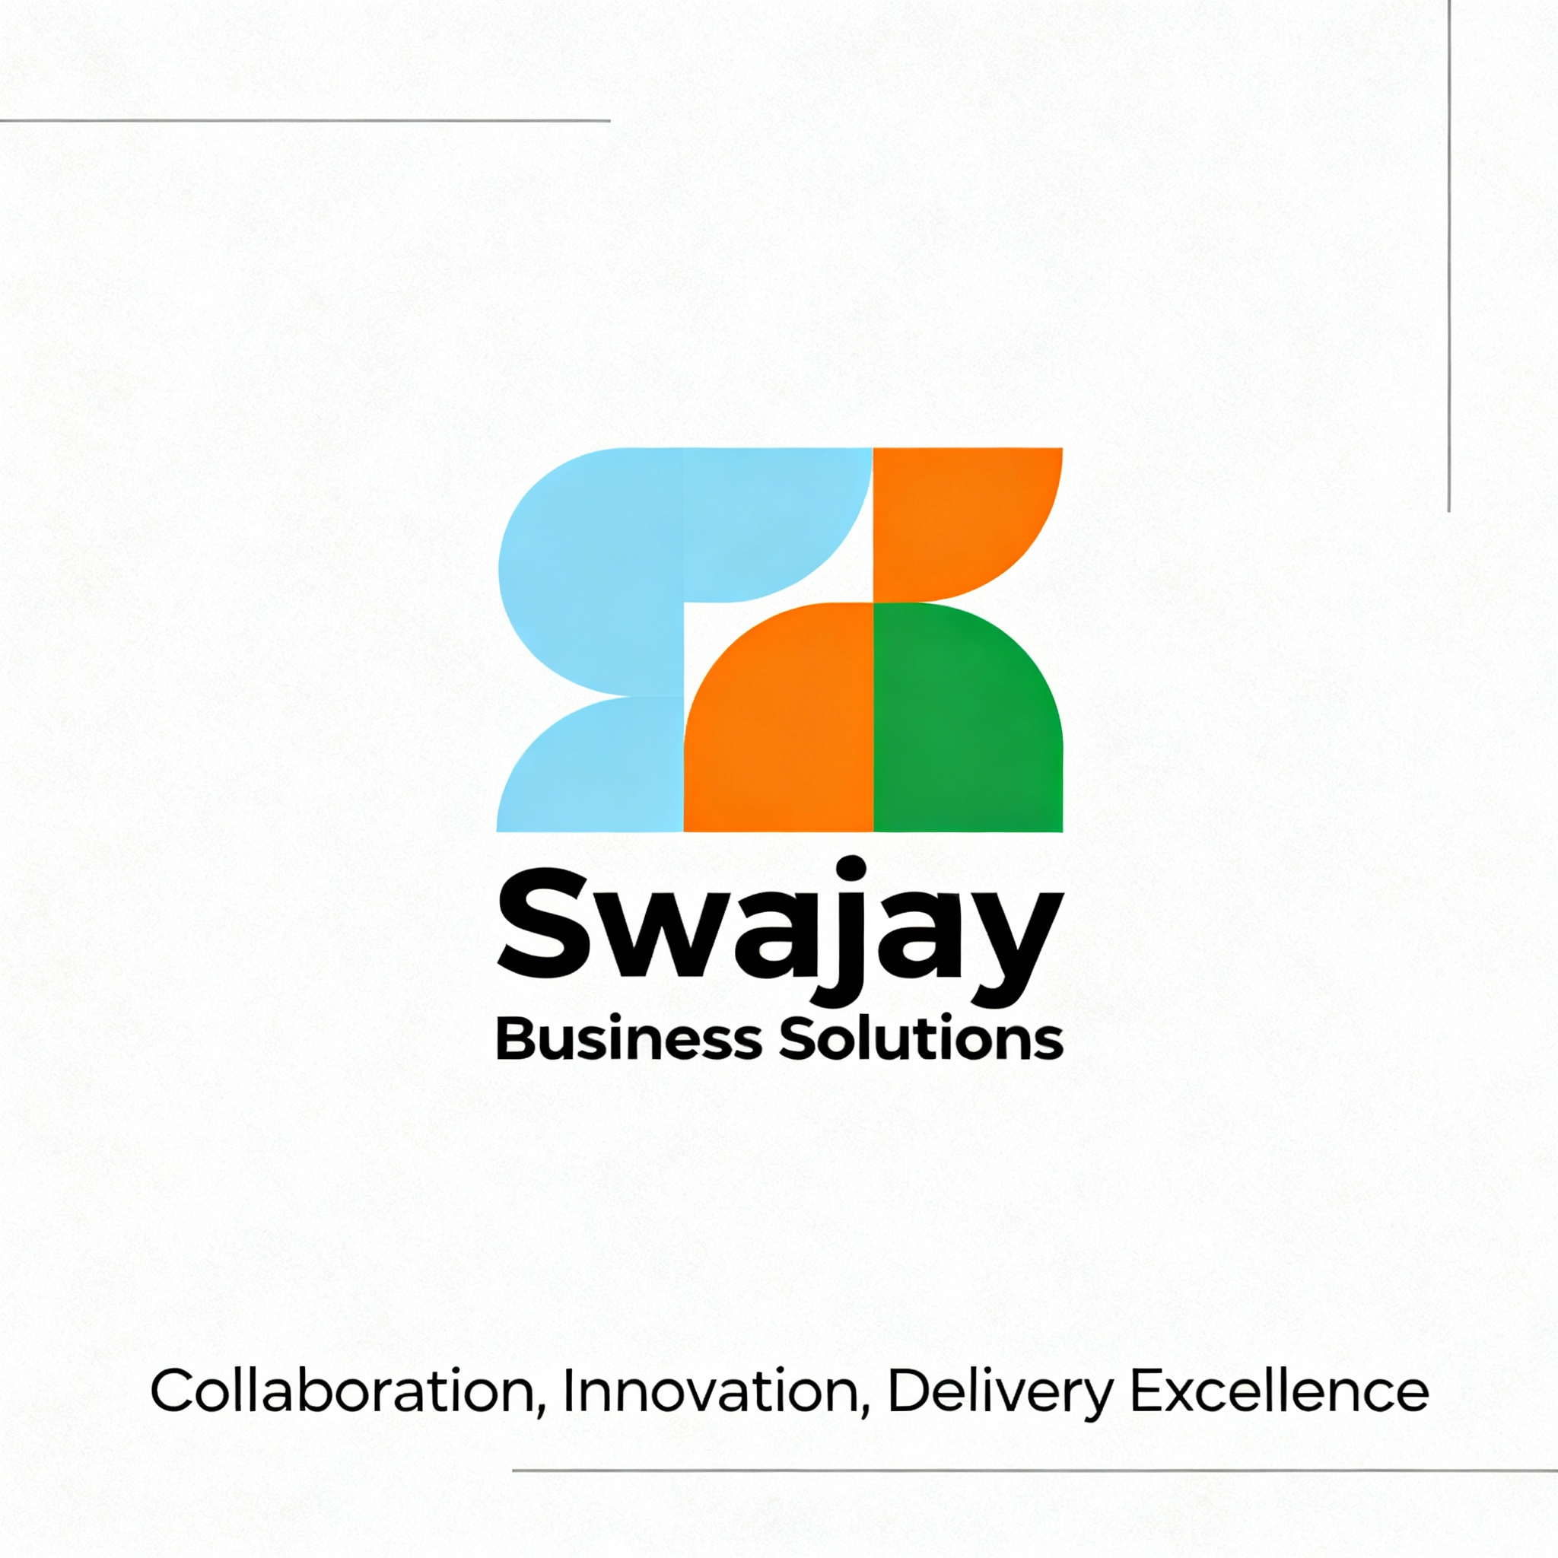
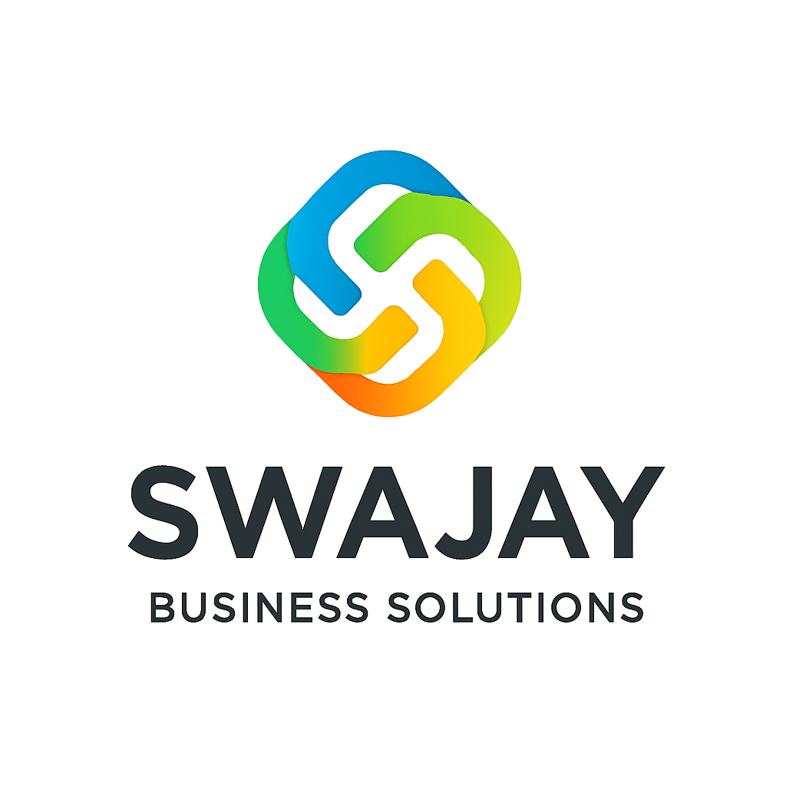
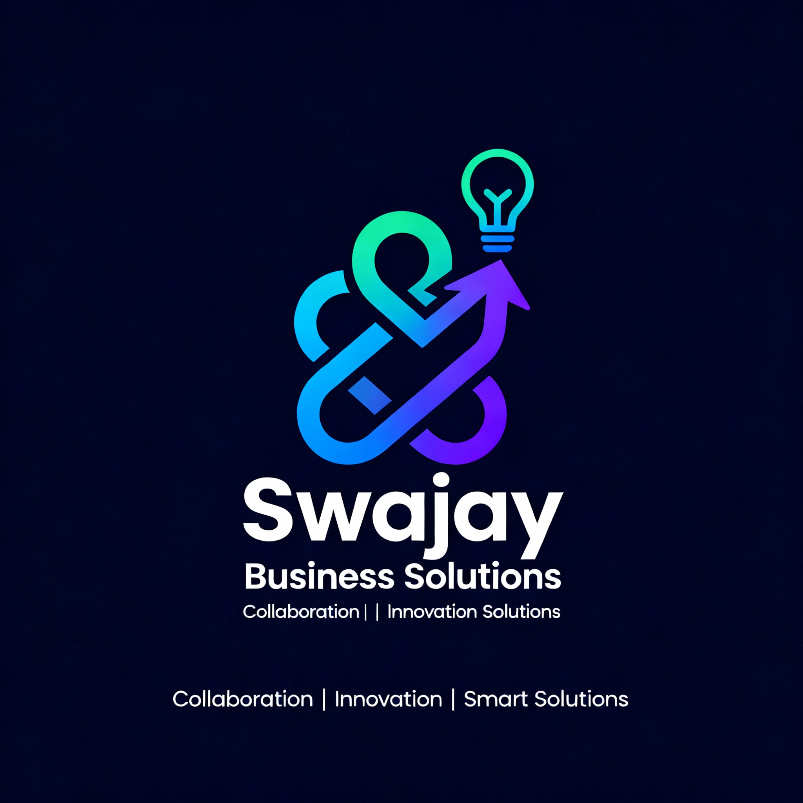
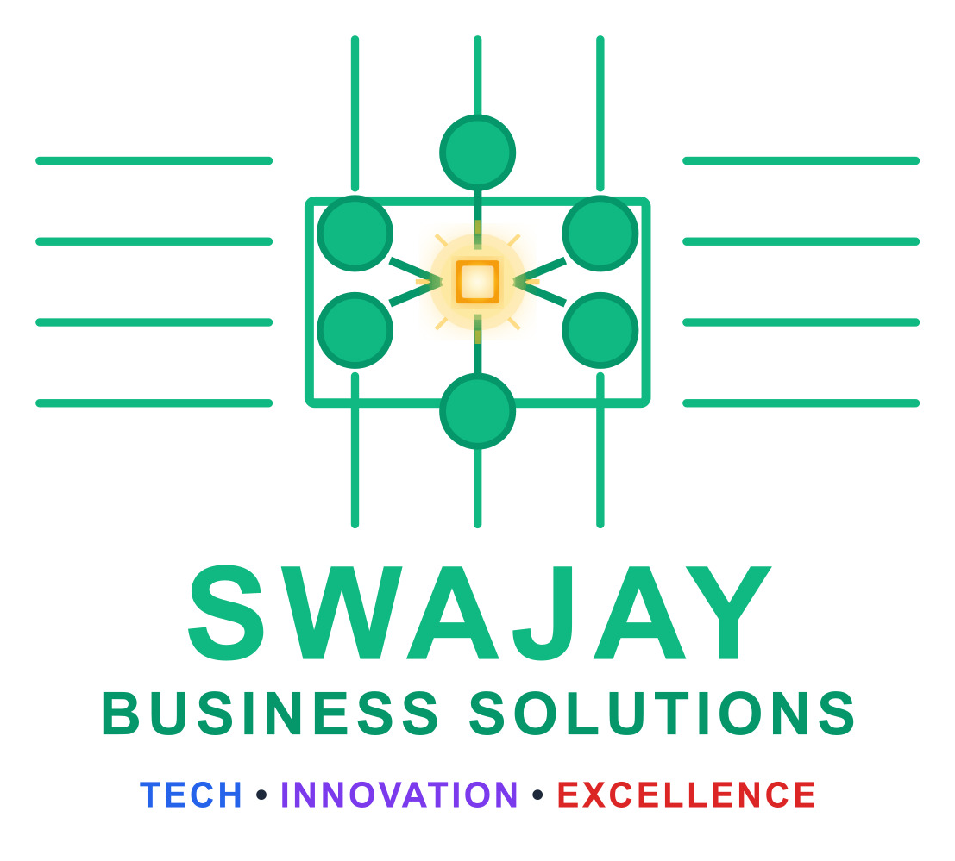
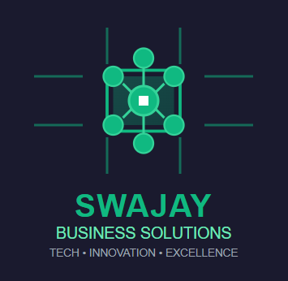
Our Logos

Slide 20





Our Blueprint of Technology Excellence
Engineering Services
AI & Automation
Data & Analytics
Cloud & Infra services
Integration Solutions
Web & Mobile Application development
Product Development
Technology Consulting
Quality Engineering
Workflow Automation
Process Mining
Robotic Process Automation
Agentic AI solutions
Data Modernization
ETL Engineering
Data Analytics
Data Governance
Data Science
Cloud Migration
Cloud Optimization
Cloud Infrastructure Engineering
Comprehensive assessment of systems
Custom design interfaces
Service
Offerings
Java,
Python
React JS
Angular
.Net / C#
Appium
Blue Prism, Automation Anywhere, UIPath, Power Automate
Selenium
ChatGPT/Claude.ai/Perplexity
Snowflake, Python
Data Stage, DBT, SSIS, Snaplogic & Informatica
Tableau, Power BI, SSRS
NoSQL (MongoDB, DynamoDB)
MySQL/MSSQL/PostgreSQL/Oracle
AWS
Azure
Kafka
Azure logic apps
Rabbit MQ
Technology & Tools

Slide 21

Swajay’s Approach: Accelerators + Squads
Building faster and smarter through specialized teams, proven methodologies, and outcome-driven collaboration.
Ready Building Squads
Lean Co-Build Squad
Specialists with deep Mortgage business and technology expertise ready to automate your processes from day one.
Product lead, designer, builders, and AI specialist working in sync. Weekly demos and transparent decision-making keep momentum high.
Outcome-First
Trust by Design
We pick one use case, define success upfront, and cut anything that doesn't move the needle. Results matter more than activity.
Privacy, access control, and audit trails baked in from the start—without the jargon. Security and compliance are never an afterthought.
Model-Agnostic
We choose what fits your accuracy, budget, and region—not one "silver bullet."
Flexibility ensures the right AI for your specific needs.

Slide 22
Our Team
Our Team
Better outcomes, built together
People. Process. Technology. Forward momentum.
Our leadership team brings decades of hands-on experience across mortgage lending, servicing operations, and the broader BFSI landscape—including banking, financial services, and regulated enterprise environments. What sets us apart isn’t tenure alone, but our ability to translate deep industry expertise into consistent, measurable outcomes.
We are powered by a multidisciplinary team that blends strong domain knowledge with modern engineering. Mortgage and title specialists work alongside BFSI SMEs, AI practitioners, automation architects, and seasoned delivery leaders to solve complex business and operational challenges.
Our delivery model is designed for speed, scale, and control. Modular, pod-based teams ramp up quickly, integrate seamlessly with core banking, lending, and enterprise platforms, and evolve with your technology and compliance ecosystem.
Guiding our journey is a trusted network of industry advisors—former executives, technologists, and operators from across BFSI—who bring strategic perspective, challenge assumptions, and help us stay ahead of regulatory and market change.
We combine the agility of a focused team with the maturity of proven experience—moving quickly, while always moving with purpose.

